Slide 1
Hateful Comment Detection
Making cyber-world a better place!

Slide 2
We are AlephNull
Razwan Ahmed Tanvir(2015-1-60-111)
Shantanu Kumar Rahut (2015-1-60-114)
Sharfi Rahman(2015-1-60-134)

Slide 3

Our Motivation

Slide 4
About Dataset
Collected from kaggle
Atrributes are:
column_text
    toxic
    severe_toxic
    obscene
    threat
    insult
    identity_hate

Slide 5
Pre-processing
Training set-test set ratio 70%-30%
Use of a new class ‘hate’

Slide 6
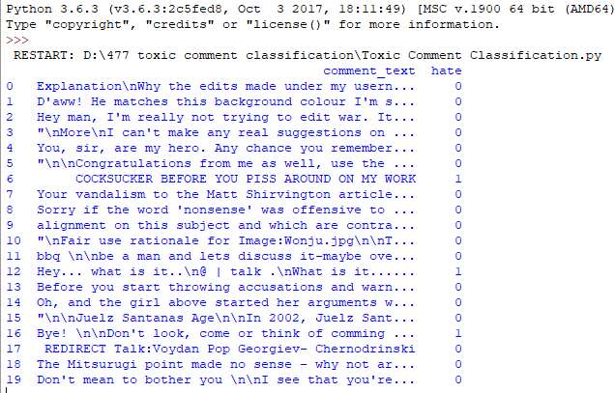
Pre-processing

Slide 7
Applied Algorithms
Naïve Bayes
Logistic Regression
Linear Support Vector Machine Classifier
Decision Tree Classifier
Random Forest Classifier

Slide 8
Result
Algorithm | Accuracy(%) | Precision(%) | Prevalence(%)
Naïve Bayes | 93.73 | 78.35
Logistic Regression | 94.90 | 90.66
Support Vector Machine | 95.03 | 79.53 | 10.37
Decision Tree Classifier | 94.21 | 74.68
Random Forest Classifier | 93.34 | 95.73

Slide 9
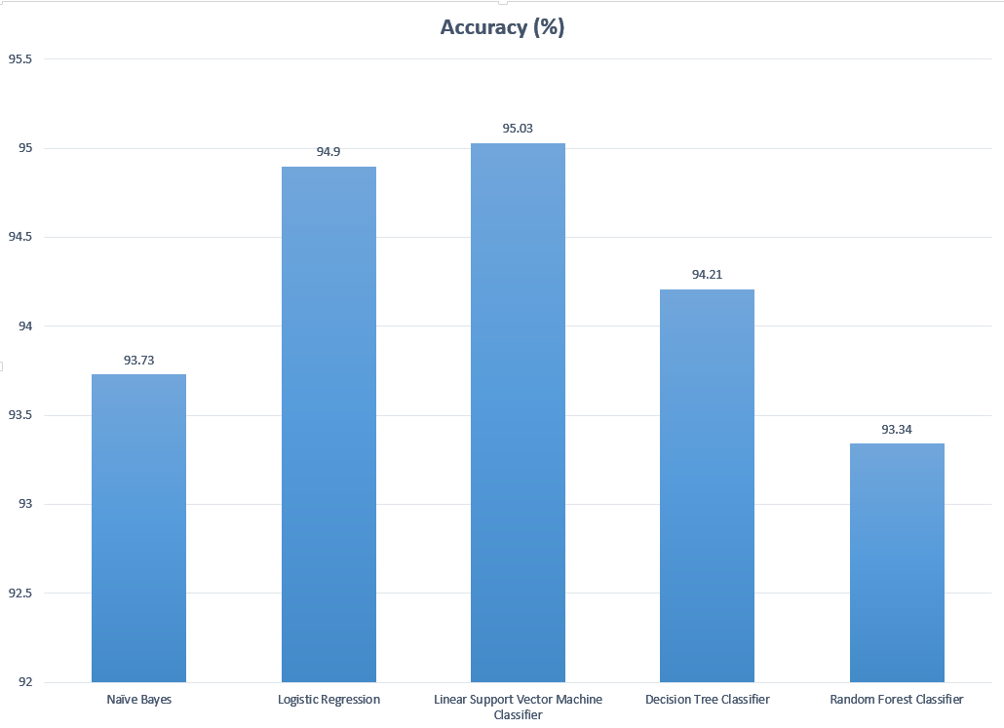
Accuracy Comparison

Slide 10
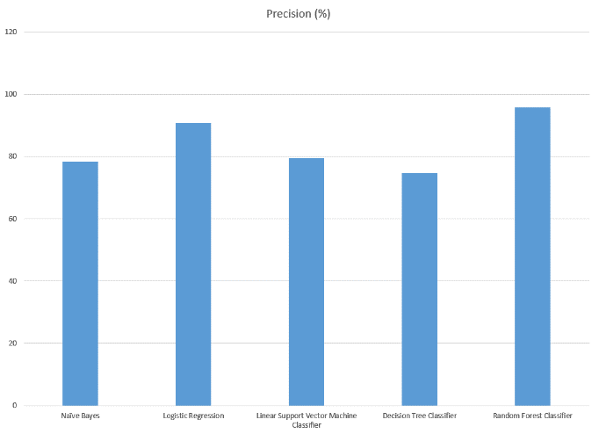
Precision Comparison

Slide 11
Conclusion
  Highest accuracy achieved – 95.03%
  Algorithm used – Linear Support Vector Machine

Slide 12

Questions?

